Slide 1
BUILDING ENGINEERING INSTITUTE Major Research Activities

Slide 2
FACULTY OF CIVIL ENGINEERING
Faculty of Civil Engineering comprises three research institutes
Institute of Building Engineering
Institute of Geotechnics and Hydro-engineering
Institute of Civil Engineering

Slide 3
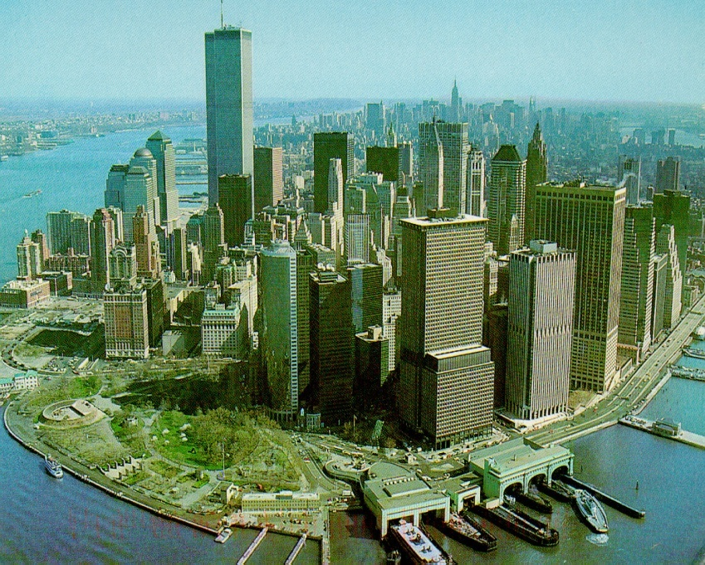
Institute of Building Engineering consists of following divisions:
Concrete Structures
Metal Structures
General Building Engineering
Building Materials, Timber Structures and Historical Construction
Building Physics and Computer Aided Design
Construction Methods and Managements

Slide 4
INSTITUTE OF BUILDING ENGINEERING
Major research activities
Comprehensive testing and technical evaluation of building structures
Non-destructive testing of building structures and materials
Evaluation of cracking behaviour of concrete composites using acoustic emission
Conservation and strengthening of timber, masonry and stone historical structures
Testing mechanical and physicochemical properties of historical building materials
Structures with glued laminated timber – study of bearing capacity, stiffness, stability, modeling and strengthening

Slide 5
INSTITUTE OF BUILDING ENGINEERING
Major research activities
Rheology of concrete, fracture mechanics, rigidity of cracked elements
Limit states of RC and prestressed concrete elements
Calculation methods for concrete bulks, theoretical and experimental investigation on silos, cooling towers, chimneys, shells
Experimental investigation on models of prestressed concrete columns and girders
Strength and stability of metal columns and beams
Theoretical and experimental studies on limit states of 3-D structures

Slide 6
INSTITUTE OF BUILDING ENGINEERING
Major research activities
Theoretical and experimental methods for safety and reliability verification of steel structures
Evaluation of critical states in thin-walled metal structures with imperfections
Destructive loads of quasi-brittle cracking of steel elements

Slide 7
INSTITUTE OF BUILDING ENGINEERING
Major research activities
Technology of building materials - modification of material structure and properties
Ceramic materials, bioceramics, brittle materials
Modifications of cement, concrete and mortar due to corrosion resistance
Rheological methods in optimisation of properties of binding materials

Slide 8
INSTITUTE OF BUILDING ENGINEERING
Major research activities
Thermographical assessment of thermal insulation of buildings
Building and environmental physics, microclimate and environment of compartments
Numerical optimisation of concrete, metal and masonry structures
CAD/CAE

Slide 9
INSTITUTE OF BUILDING ENGINEERING
Major research activities
Earth work organisation and application of stream methods in building processes
Strength and stability of structures during erection
Organization of construction and management of the investment process

